Slide 1
Who we are
Edinburgh catering services

Slide 2
Edinburgh catering services
The in-house catering service run by The City of Edinburgh Council (Edinburgh Catering Services) provides around 22,000 meals per day across the city. We manage the catering across the vast majority of schools in Edinburgh, commercial buildings and Early Years settings
Our main aim is to provide a high quality, nutritious provision to learners and service users across Edinburgh and to actively promote the role of nutrition in raising attainment
We work across 100 buildings across Edinburgh, making us the largest provider of meals across the city
Edinburgh Catering Services work with both national and local suppliers to deliver great quality ingredients into school kitchens every day

Slide 3
Our team
We employ 600 dedicated colleagues across the city and have one of the highest retention rates across the hospitality industry
Our team are all passionate about delivering a great quality service to pupils across Edinburgh, we invest heavily in our people as they really are the heart of our business
All our staff have access to a wealth of learning resources and we are currently launching our “Chefs Academy” to develop the next generation of school chefs!
We have a senior team lead by our Head of Service comprising of Area Managers, Field Supervisors, Menu Development Officers and Operational Support such as training, recruitment and procurement

Slide 4
Our Food
The majority of our menu choices are cooked fresh on site every day – to comply with Food for Life a minimum of 75% of dishes are scratch cooked daily
Our menus are written to balance pupil choice with the most stringent of school food standards in the UK
All our menus are nutritionally analysed and new dishes trialled by pupils prior to menu launch
All our meat is either Quality Meat Scotland or Red Tractor Assured
All our dairy comes from Scottish Farms
All eggs used are Free Range
All fish is MSC certified
We believe in sourcing food with provenance and aim to increase our spend with Scottish suppliers every year

Slide 5
Our Menu was designed to comply with the national requirements for food and drink in schools (Scotland) Regulations 2020
A wide selection of seasonal fruit, vegetables and salads will be available every day.
Our cooks make lovely freshly baked bread at least twice per week.
Our daily homemade soups are filled with lots of yummy hidden vegetables.
Our ham sandwiches have been replaced with chicken sandwiches to reduce the amount of red processed meat that’s being served.
Our yogurt recipes have been re-formulated to have less sugar in them.

Slide 6
Our Suppliers
Edinburgh catering services

Slide 7
GEORGE ANDERSON & SONS
George Anderson & Sons are a Fresh Produce Company based in Macmerry, East Lothian. Founded in 1978 in Musselburgh by George Anderson.
We are one of the last Scottish family fresh produce companies left and are now owned by George’s two daughters.
We supply fruit, vegetables, pre-pared vegetables, bread and eggs to The City of Edinburgh Council.
When the weather permits, the buying team at George Anderson & Sons source as much of our produce from Scotland. We get our soft fruit from Leven, Fife, pre-pared vegetables from Arbroath, pre–peeled potatoes from Samuelston, East Lothian, root vegetables from Ayrshire and Tayside, baking and salad potatoes from Duns and very recently added, Scottish tomatoes from Denholm and eggs from Peebles, both in the Scottish Borders
Our fleet of 23 refrigerated vehicles, all with Euro 5 engines, keeps our emissions low and we reduce our carbon footprint by picking up the produce we source in Scotland on the way home from our deliveries .
Do you know George Anderson & Sons source 78% of all produce supplied to The City of Edinburgh Council, from the UK.

Slide 8
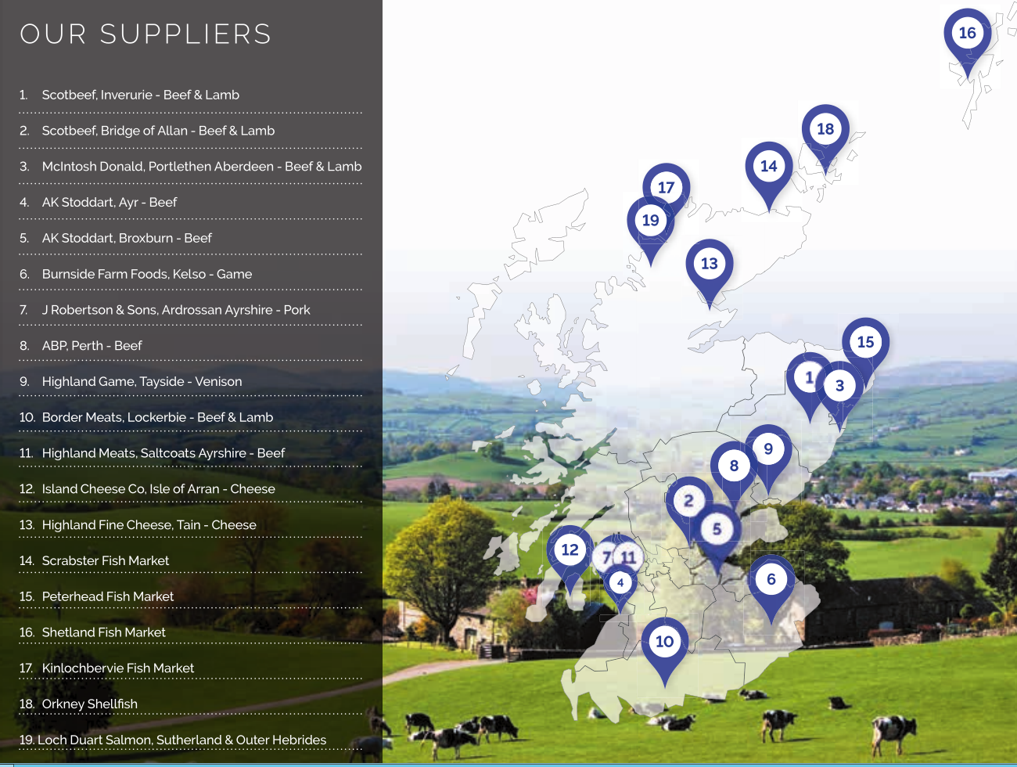
Campbells Prime Meat
Who we are – We are Scotland’s leading supplier of fresh meat, fresh fish and delicatessen products into foodservice. We deliver everything from dry aged Scotch beef to smoked Scottish salmon and Scottish cheeses.
Local Sourcing – We work within our supply chain to support the local economy by sourcing many of our key products within Scotland such as beef from Bridge of Allan and Broxburn.
Sustainability –
We are committed to reducing our carbon footprint by 88%. Of factory waste was recycled/reused in 2021 – 1,240 tonnes of waste recycled/reused
Ground source heat pumps used to help heat our hot water
All internal factory lighting is now LED
Lighting in factory corridors and infrequently used areas are now controlled by Passive Infrared Sensors
Interesting fact – Did you know the haggis that the council buy originated from John “Niffy” Campbell, one of Thomas Campbell’s five sons. He was the first haggis maker in the Campbell family business over 100 years ago.
Picture/food map/etc here

Slide 9
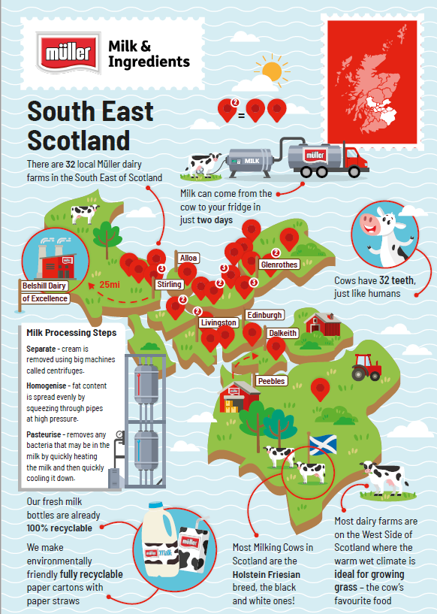
Example company
Müller Milk & Ingredients – One of the nations favourite brands Müller Milk | Müller Milk | Our Brands | Home (muller.co.uk) – our dairy has been producing milk for the Scottish councils contracts for over 30 years.
Local Sourcing – We supply only Scottish milk to the Scottish councils collecting it from around 193 Scottish farm which helps support farmers with fair prices for their milk. It is important not to waste a drop.
Sustainability – We lead on plastics propositions in the dairy industry, blow moulding our own bottles with 30% recycled material. We will be net zero by 2050, and are already well ahead of this target. Using paper straws on our school paper cartons meant the removal of 48 tonnes of plastic from the environment.
Interesting facts – Did you know that Edinburgh Council’s children are second from the top as ‘the best milk drinkers’ across the whole of Scotland? Keep drinking your healthy milk and let’s get you back to that no. 1 spot.
Picture/food map/etc here

Slide 10
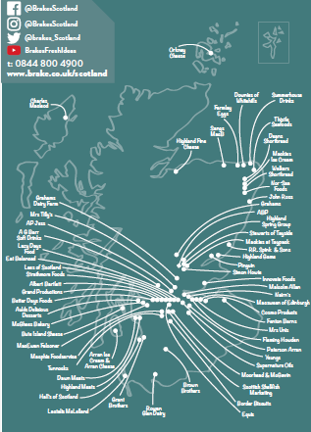
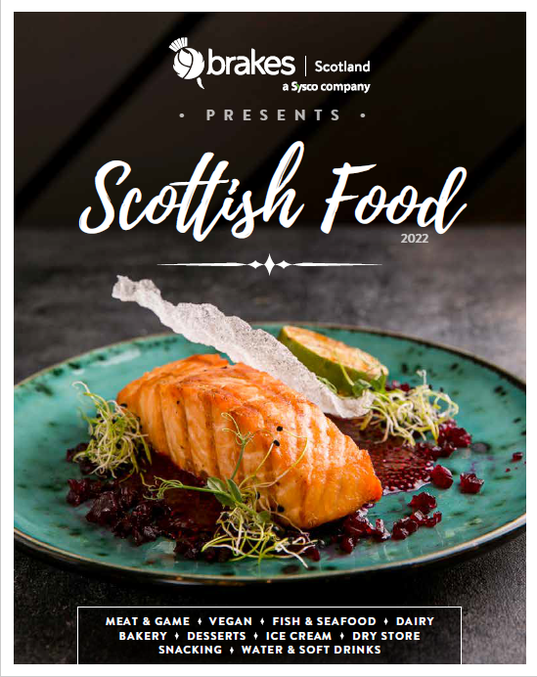
Example company
Who we are – Brakes has supplied Scottish Businesses for over 60 years, employing nearly 600 local people and partnering with over 100 Scottish suppliers. Brakes invented modern food wholesaling and provides the highest quality of fresh and frozen food and ingredients to some of the nation’s Michelin-starred restaurants. We also provide to schools, caterers, care homes and hospitals servicing more than 8,000 customers across Scotland. Operating from four sites across Scotland; Inverness, Oban, Dundee and Newhouse, Brakes offer customers a fully multi-temperature service and over 600 Scottish product lines. Brakes Scotland is owned by Sysco, a world leading supplier to the foodservice sector in the UK, Ireland, France, Sweden, and America.
Local Sourcing – We work within our supply chain to support the local economy. We work with over 100 Scottish suppliers selling more than 650 Scottish products.
Sustainability – We are committed to reducing our carbon footprint by putting zero product to landfill, reducing our wastage by donating to foodbanks and condensing our routes to put less vehicles on the road as well as looking at electric vehicles.
Interesting fact – Brakes have contributed over £11 million in sales to the Scottish economy through the sale of Scottish products over the last 12 months.
Picture/food map/etc here

Slide 11
Who we are –Founded in 1974, we are the largest Scottish independent distributor in non-food supply to councils.
Local Sourcing – We work with UK based manufacturers as a preference and deliver from our Livingston depot.
Sustainability – We supply biodegradable and compostable packaging as well as eco-friendly cleaning materials.
Interesting fact – When the council changed its paper towel and toilet roll systems it saved over 30% in paper wastage

